Slide 1
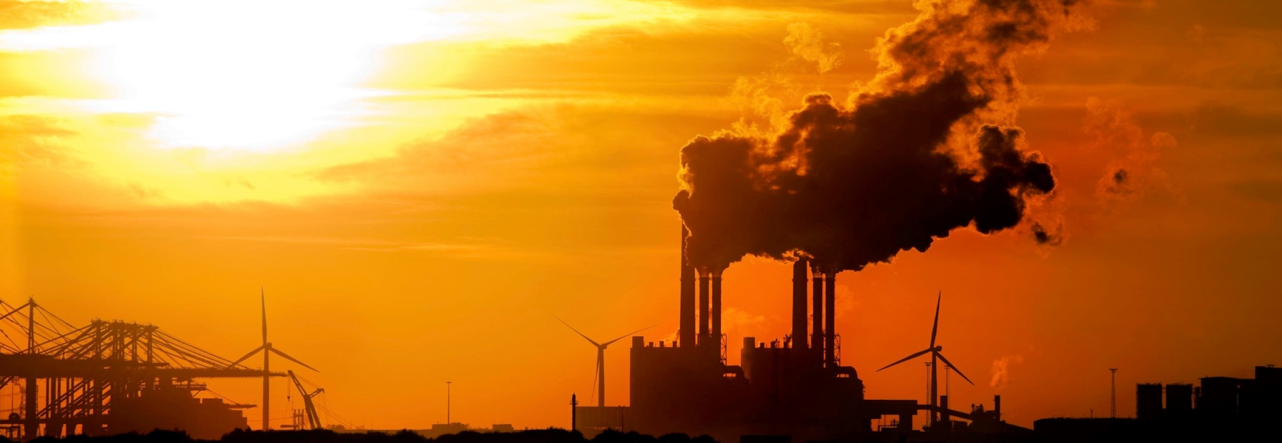
Emissions Modeling
Daniel Tong
UMD CICS / NOAA ARL
June 22, 2016

Slide 2
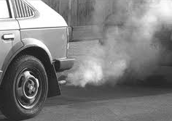







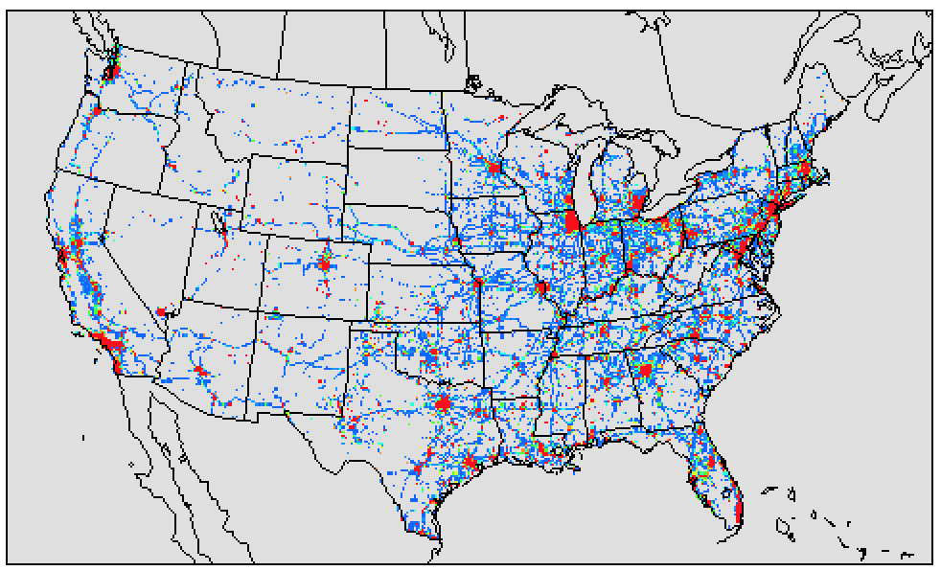
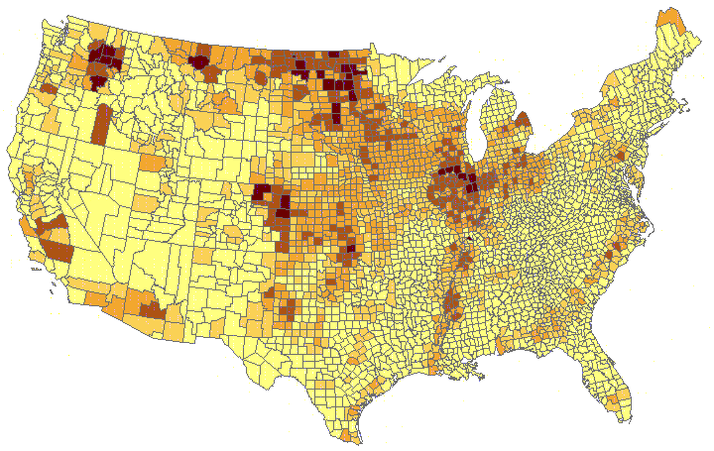
Emissions Modeling
Air Quality Forecast
Real World Emissions
Meteorology Forecast
Emission Forecast
Model-ready Emission
Emissions Inventories

Slide 3
Emissions for Air Quality Forecasting (AQF)
Time lag is a major obstacle for AQF
  Forecasters want: emissions for tomorrow
  Data availability: emissions data 4+ years old
How to overcome this problem?
NAQFC Practices:
  Option 1, no update (2007-2011)
  Option 2, use EPA projection (2012-2015)
  Option 3, emissions data assimilation (2016-)

Slide 4
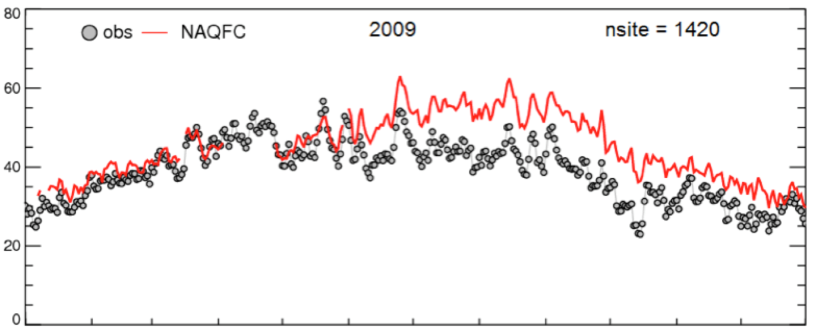
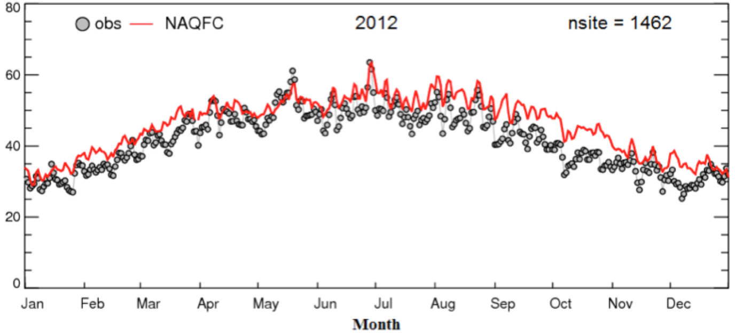
NAQFC Ozone Forecast
2009:
NEI Only
NEI: National Emissions Inventory
Peak 8h Ozone (ppb)
2012:
NEI with Projection
(Tong et al., 2015)

Slide 5
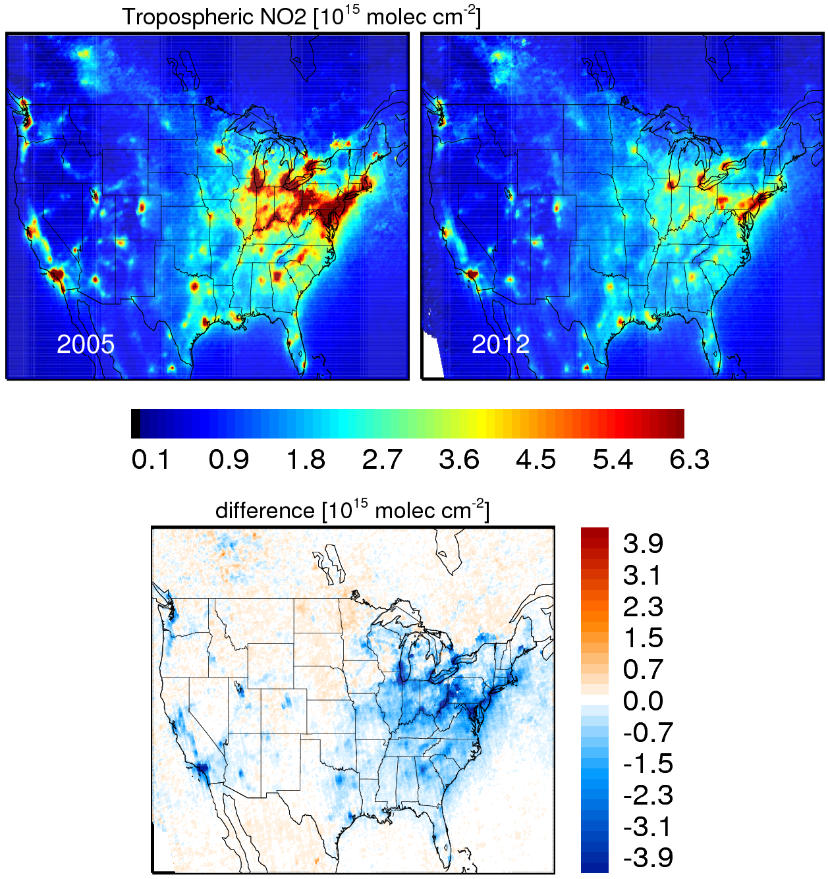
Tropospheric NO₂ Changes from OMI
(OMI: Ozone Monitoring Instrument)
2005
2012
Difference

Slide 6
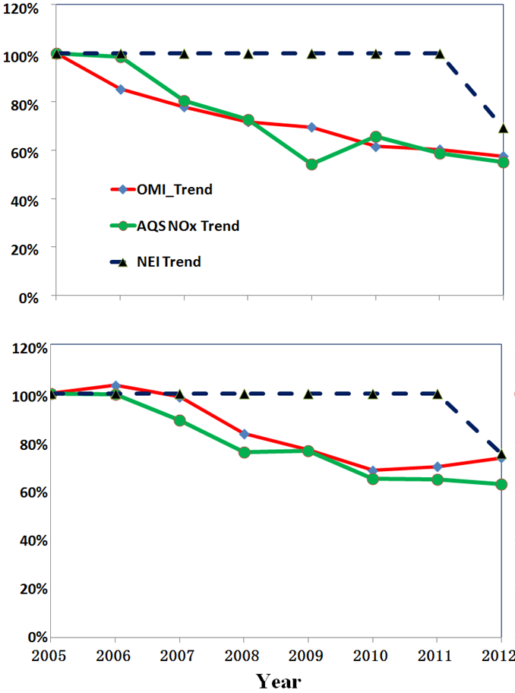
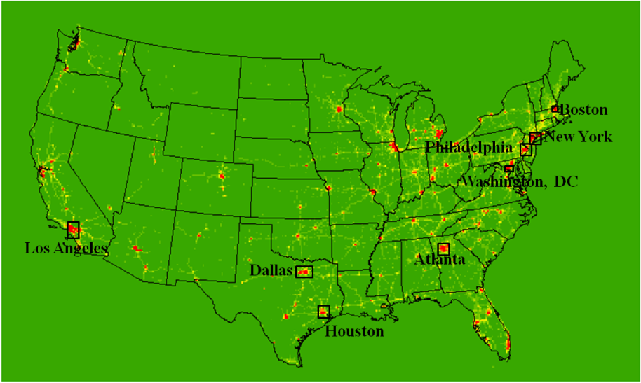
NO_{x} Trends from OMI, AQS and NAQFC
Comparison to 2005 values
Atlanta
Philadelphia
OMI (Space)
AQS (Ground)
NAQFC (Model)
Philadelphia
OMI = Ozone Monitoring Instrument on NASA’s Aura Satellite
AQS = Air Quality System
Atlanta

Slide 7
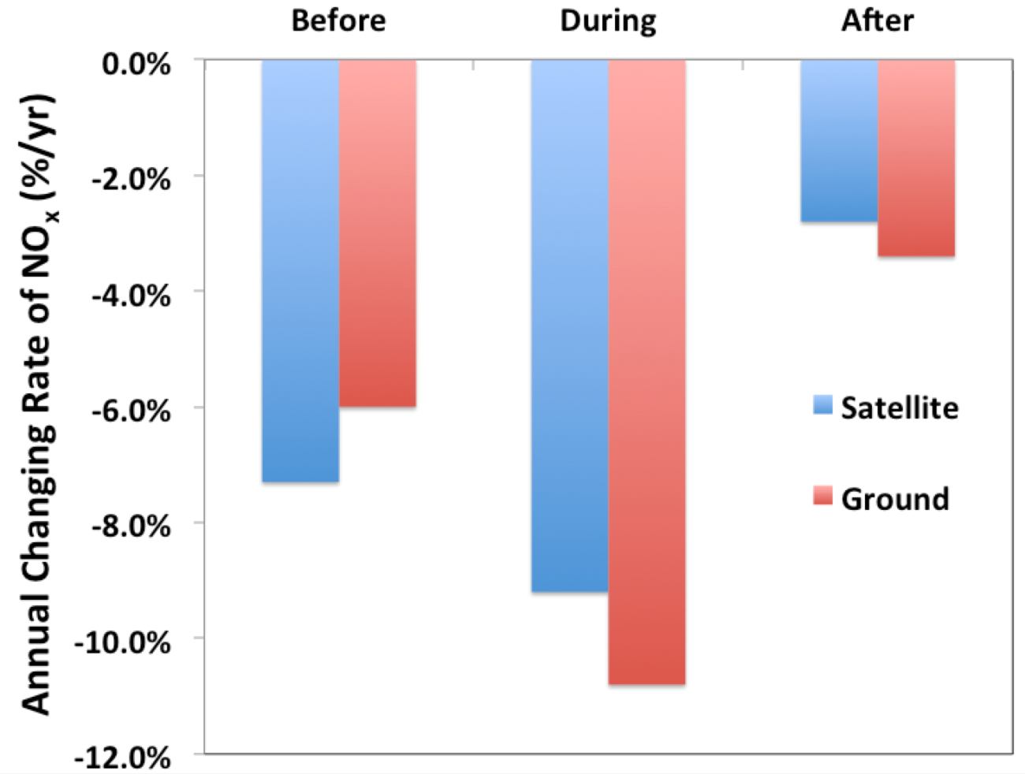
NO_{x} Trends during the Great Recession
Consistent trends from OMI and AQS;
Faster NOx reduction during the Recession and slower after that.
(Tong et al., 2015)

Slide 8

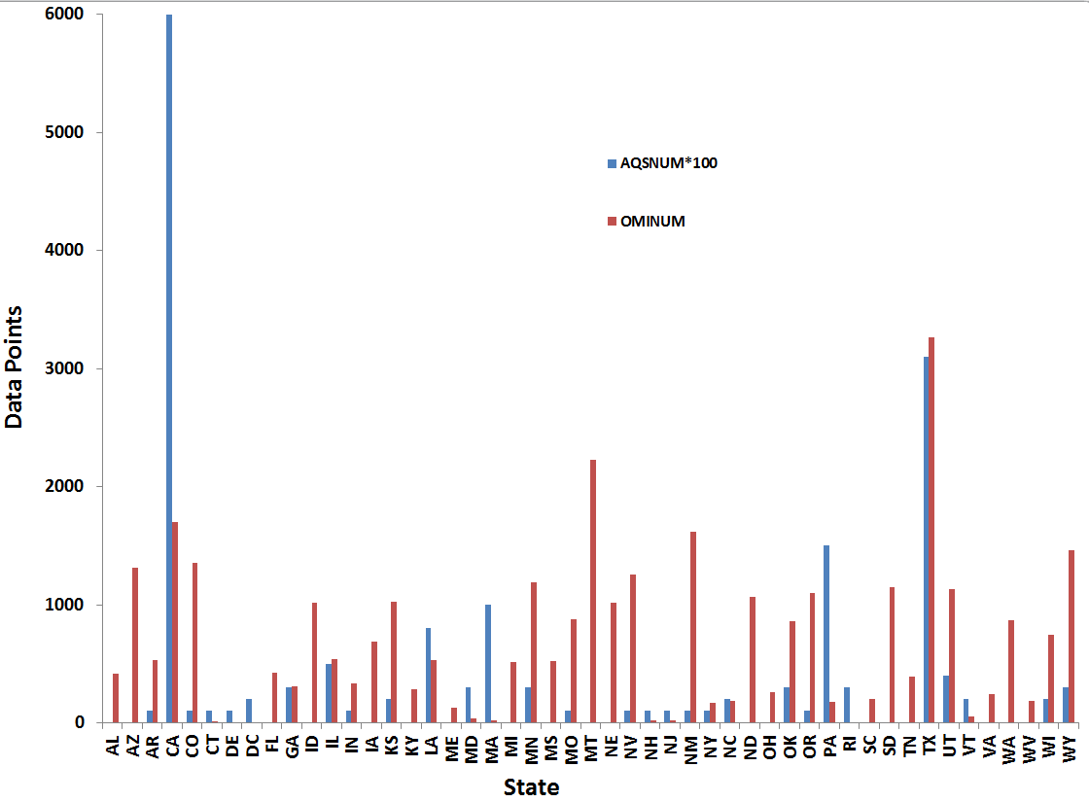
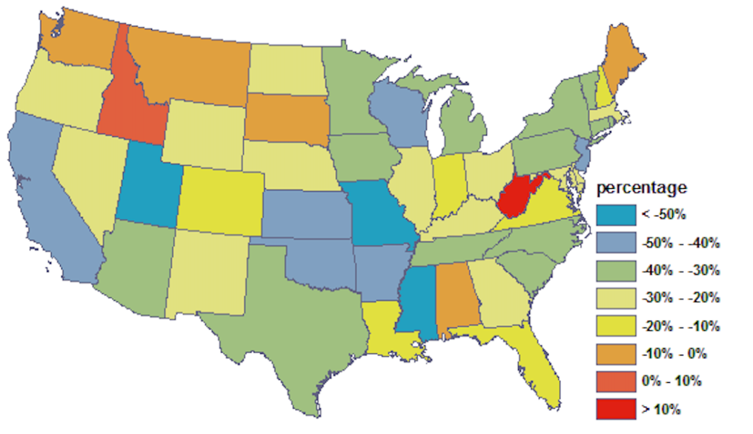
Rapid Refresh of NO_{x} Emissions
Question: Can satellite and ground data be used to rapidly refresh NOx emissions?
Fusing AQS & OMI
State-level Projection Factors
Comparison of OMI and AQS (x100) Samples
(2005 to 2012)
8

Slide 9
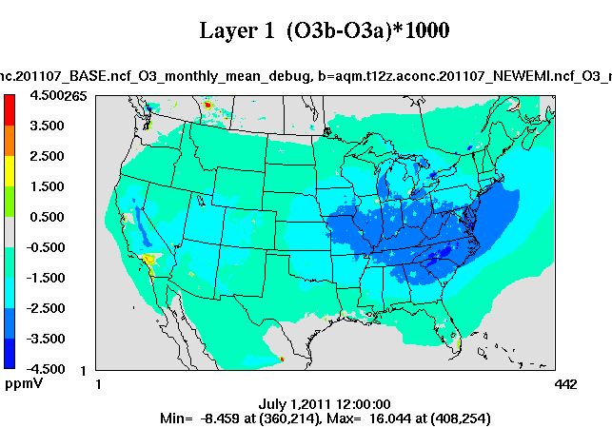
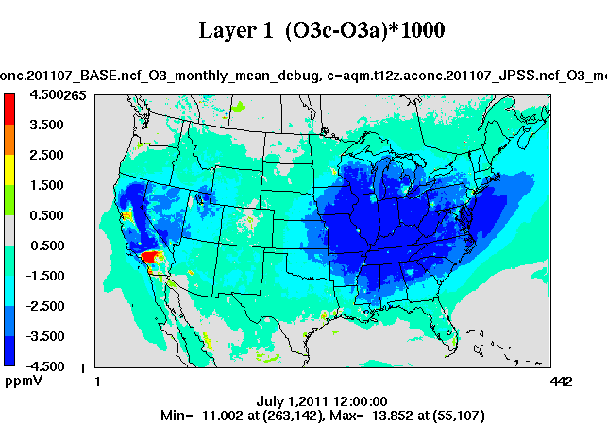
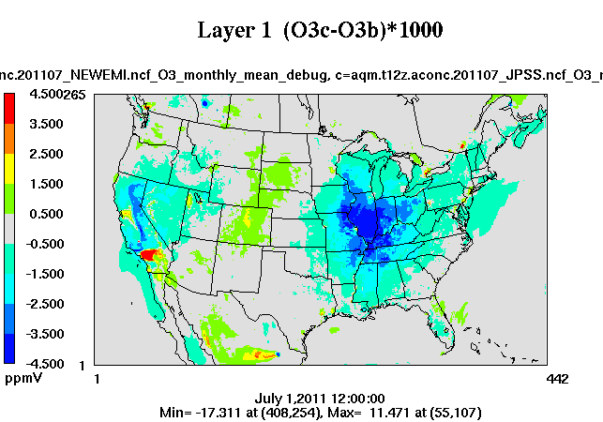
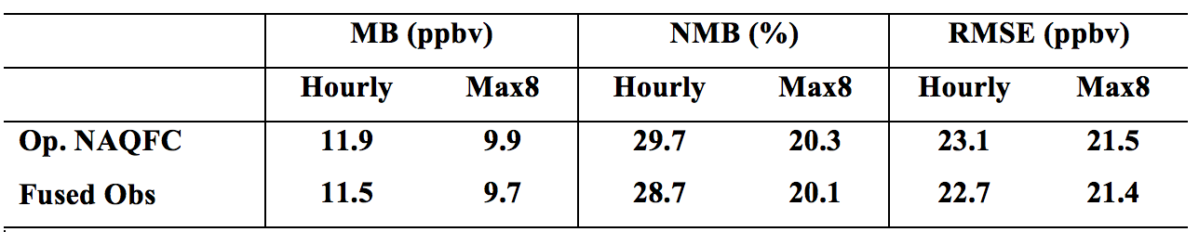
Effect on O₃ Forecast
Effect of Using
EPA Projection
Effect of Using
Fused Obs.
Difference
Performance Metrics (July 2011 over CONUS)

Slide 10
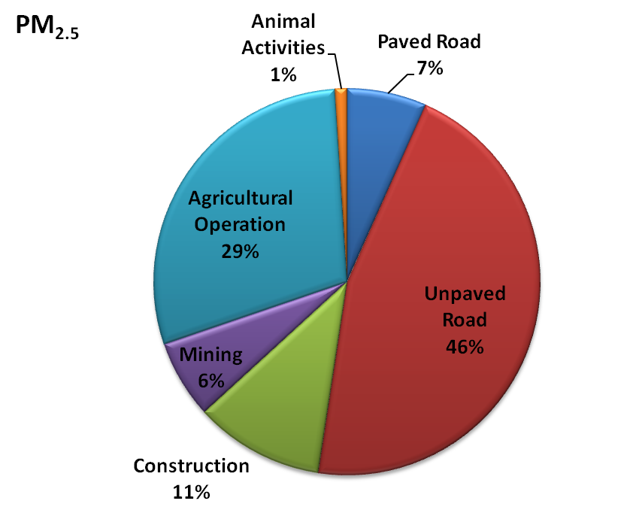
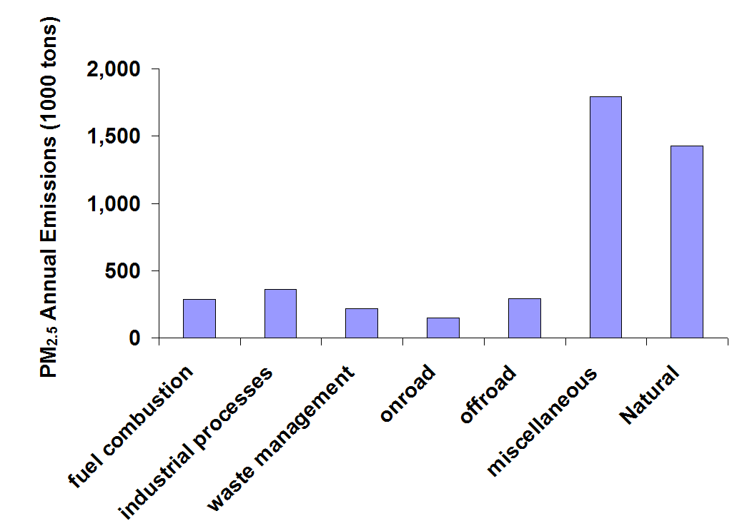
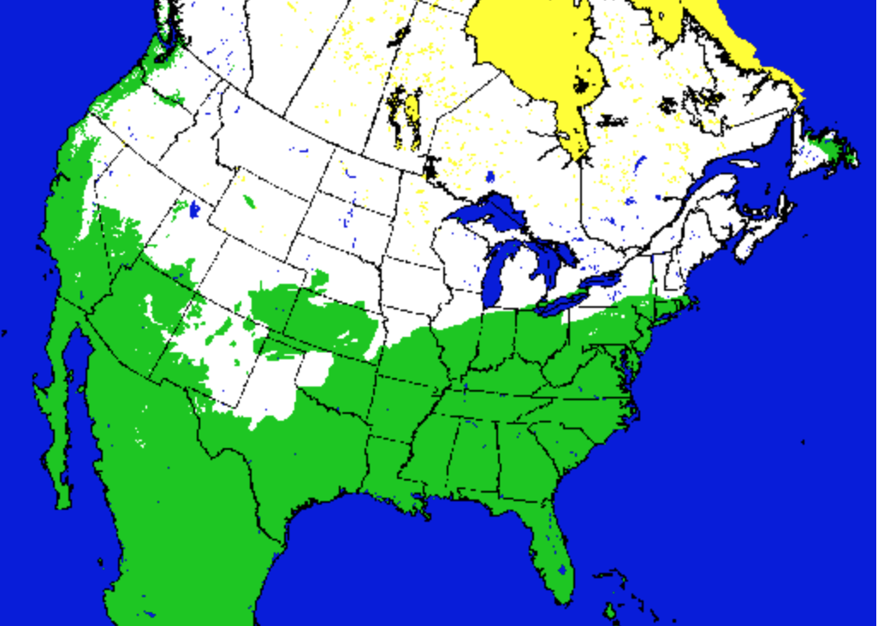
Weather Aware Emission: Snow/ice effect
Anthropogenic
?

Slide 11
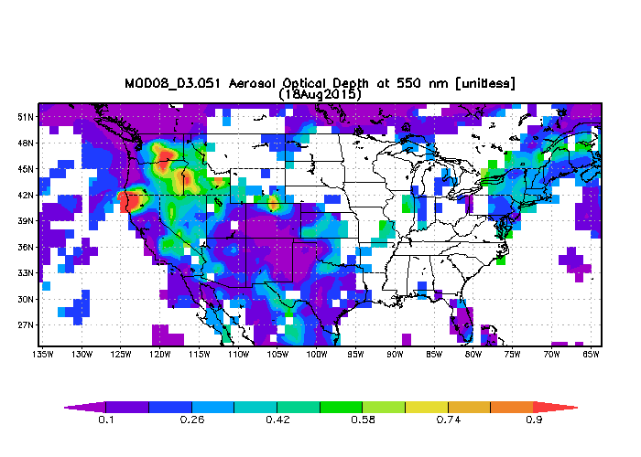
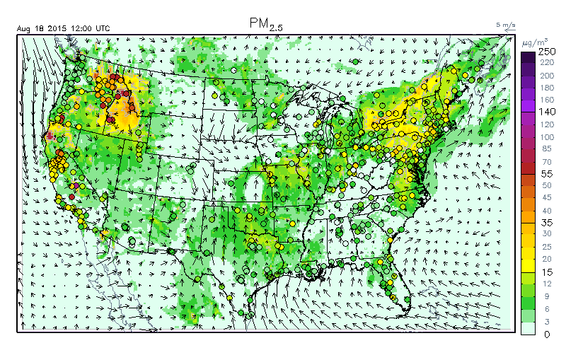
Dynamic Fire Emissions
Fire detection: NOAA Hazard Mapping System
Emissions estimation: BlueSky
ARL modifications for optimal performance
NAQFC PM_{2.5} Forecasting
Aqua MODIS AOD

Slide 12

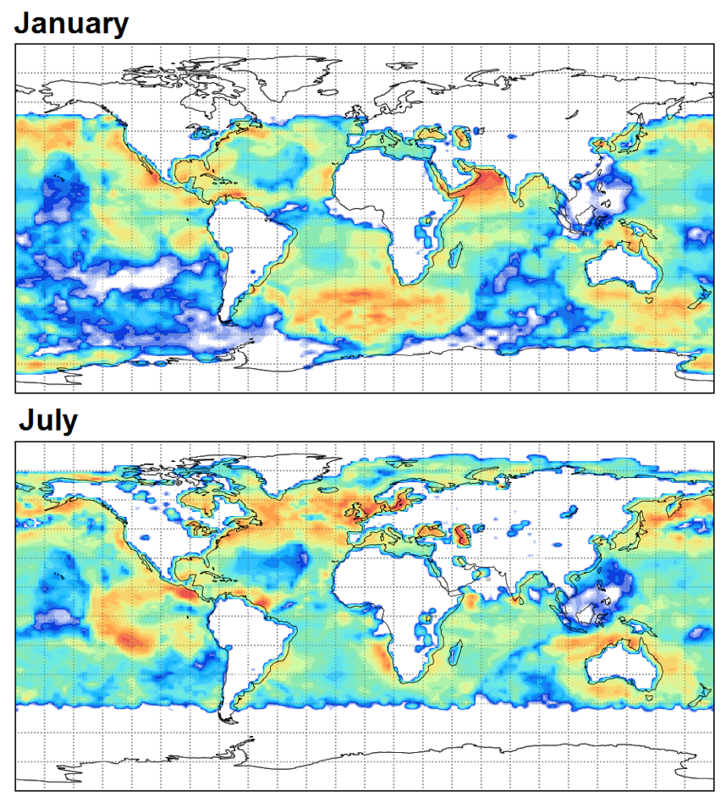
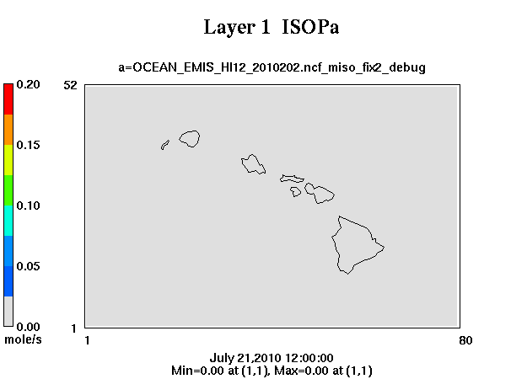
Satellite Retrievals of Marine Emissions
Validation
2013
NAQFC Hawaii Domain

Slide 13
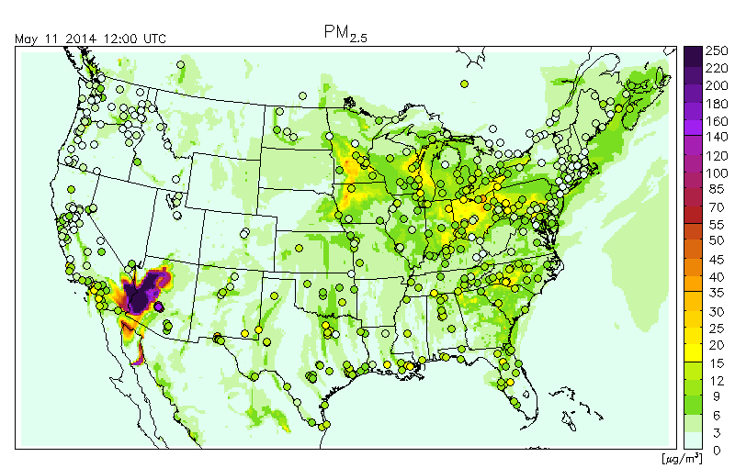
Blowing Dust Event -- PM_{2.5} Forecast
NOAA/NESDIS
HMS Dust Observations:
California/Arizona: An area of moderately/dense blowing dust was visible sweeping across northern Baja California/Arizona into western New Mexico behind a strong cold frontal boundary.

Slide 14
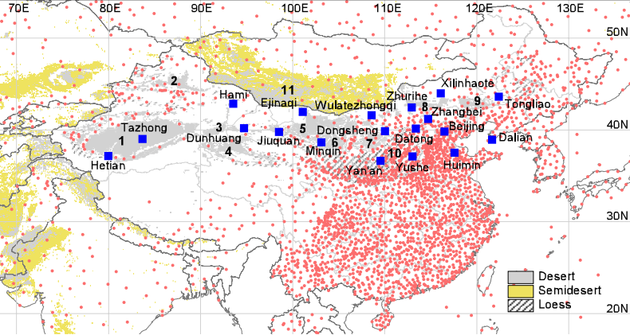
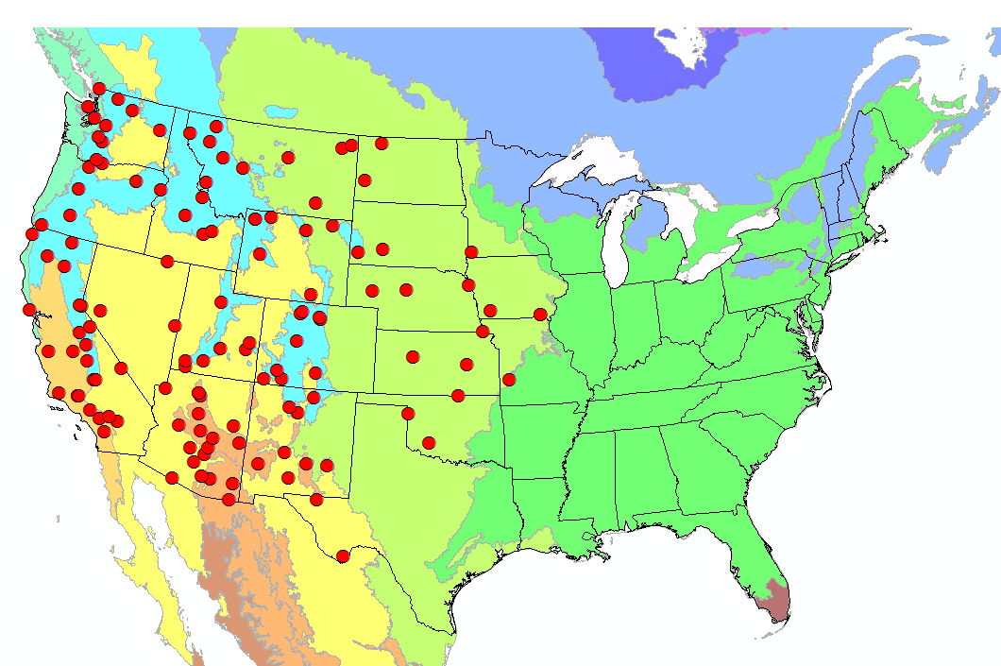
Dust Observations to Verify Forecasts
Chinese Sand and Dust Network
The US Aerosol Network IMPROVE
(Wang et al., 2008)

Slide 15
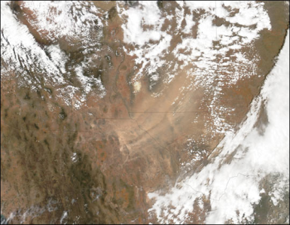
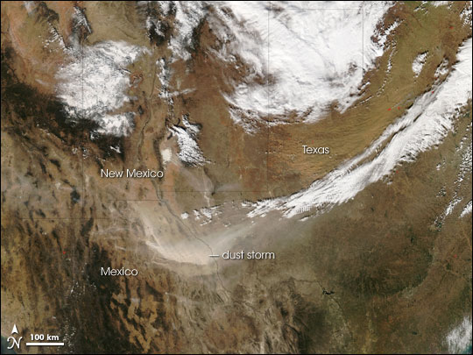
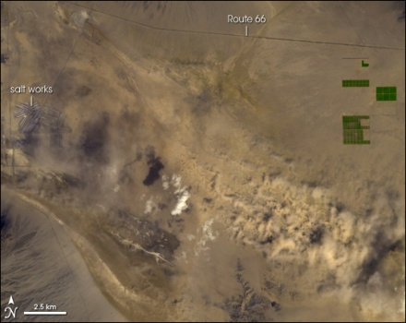
Satellite-aided Algorithm Development
Apr. 15, 2003
Nov. 27, 2005
DEVA
SAGO1
GUMO
GUMO
Apr. 12, 2007
BIBE
Crustal (mg/m³)

Slide 16
Satellite-aided Algorithm Development
Apr. 15, 2003
Nov. 27, 2005
DEVA
SAGO1
GUMO
GUMO
Apr. 12, 2007
BIBE
PM_{2.5}/PM₁₀

Slide 17
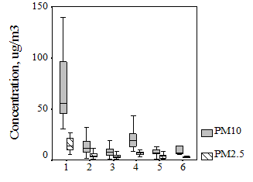
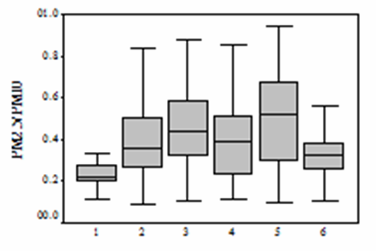
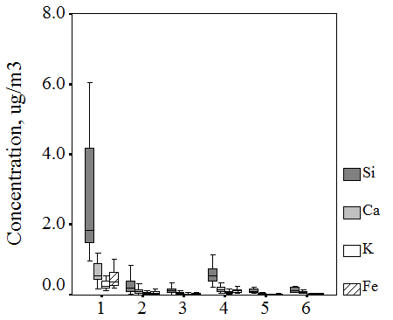
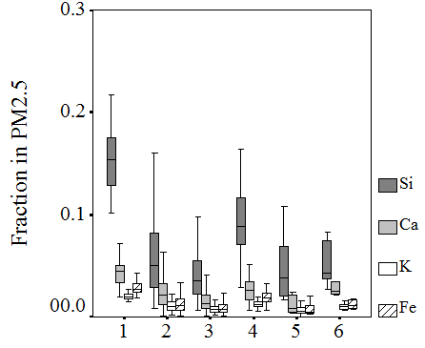
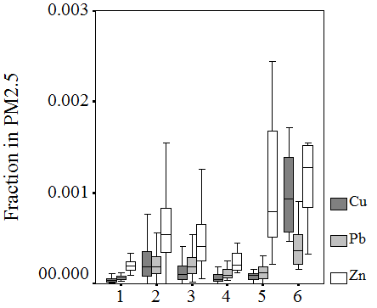
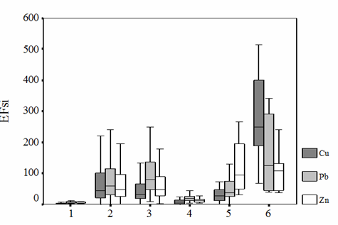
Identify Dust Storms - Cluster Analysis
PM10,PM_{2.5}
PM_{2.5}/PM₁₀
  High PM₁₀, PM_{2.5}
  Low PM_{2.5}/PM₁₀
  High Crustal Fraction
  Low Anthropogenic Fraction
  Low Enrichment Factor
Crustal Element Concentration
Crustal Element Fraction
Cu, Pb, Zn
Enrichment Factor

Slide 18
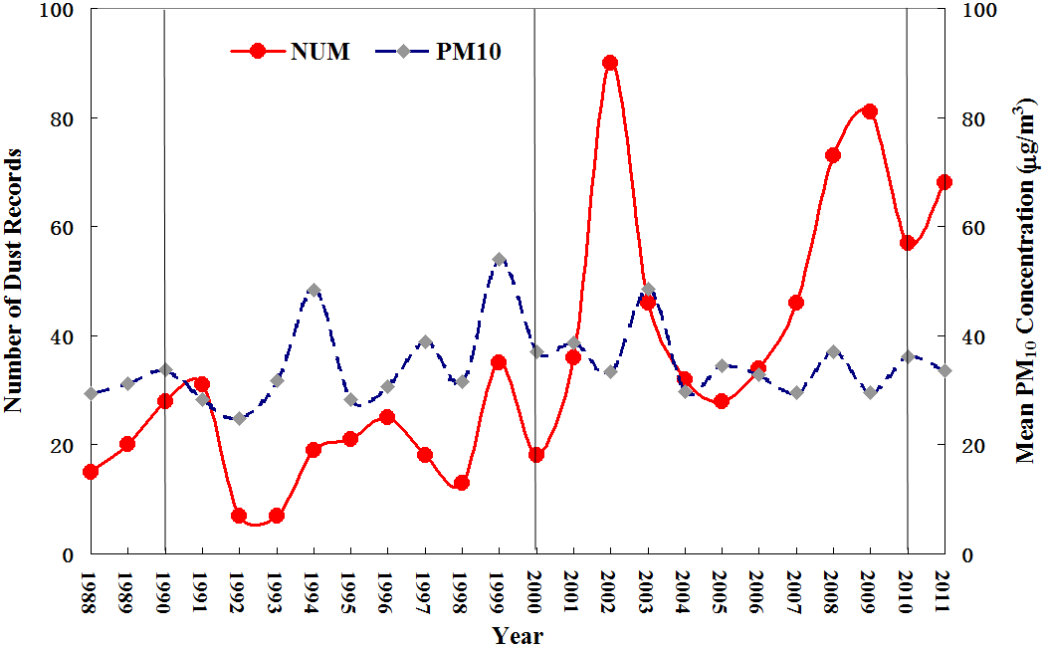
Dust Trend in the United States
Total: 204
Total: 480
Dust storms become more frequent

Slide 19
Dust and Valley Fever
Coccidioidomycosis, commonly known as Valley Fever, is an infection caused by inhalation of a soil-dwelling fungus.
Valley Fever
Dust Region
The incidence rate of valley fever has increased by eight-fold from 1998 in 2011 in the same regions where increased dust frequency is detected.

Slide 20
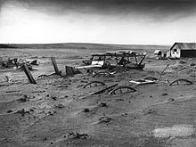
Dust Bowl: Threat to US Economy
Dust Bowl- One of the worst man-made catastrophes in US history
  Huge dust storms caused by
  droughts and poor land use
  Stripped 75% of top soils
  2 millions lost homes
  Destroyed agriculture (30s-50s)
Another Dust Bowl inevitable in late 21 st Century?
  Much drier conditions later this century (Cook et al., 2015)
  “Dust-bowlification” rather than desertification in the American subtropics (Romm, 2011)

Slide 21
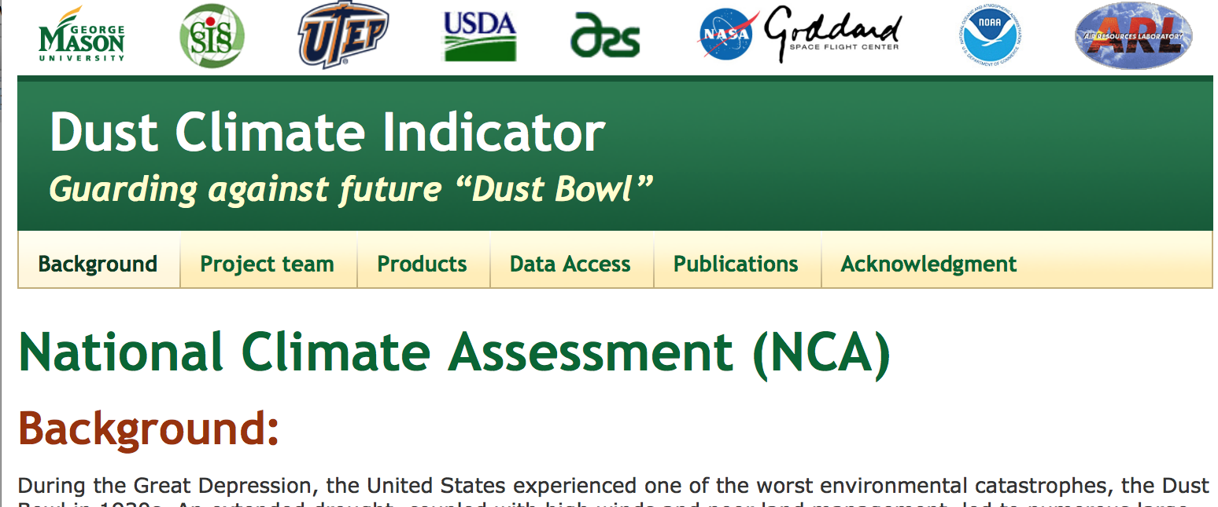
Dust for National Climate Assessment
The U.S. Global Change Research Program (USGCRP), mandated by the Global Change Research Act (1990), prepares a report to Congress every 3 years.
A key task of National Climate Assessment (NCA) is to develop a suite of climate indicators (physical, ecological, and societal).
NCA Dust Climate Indicator
Baseline
Trend
Climate drivers
Predictability

Slide 22
Quality
Publications
28 publications in peer-reviewed journals (2011-2016)
Reimbursable Support
NOAA Joint Polar Satellite System (2012-2015)
NASA ROSES & USGCRP (2012-2014)
NSF EarthCube Initiative (2014-2016)
US Weather Research Program (2015-2016)
NASA ROSES & USGCRP (2016-2018)
NOAA US Weather Research Program (2016-2019)
NOAA Climate Program Office AC4 (2017-2019)
Award
USEPA Scientific & Technological Achievement Awards

Slide 23
Summary
Advance emissions science to support NOAA chemical weather forecasts
Emissions rapid refreshing capability
Weather-aware emissions
Intermittent emission sources (dust, fire, etc.)
Produce high-quality emission products to serve the community at large
Products to support field campaigns (NASA, NOAA and NSF)
Satellite products of marine emissions
Dust records for national climate assessment

